Slide 1
Computational Systems Biology for Medical Applications Modeling Essentials
Joseph L. Hellerstein*
Herbert Sauro**
*eScience Institute, Computer Science & Engineering
**BioEngineering

Slide 2
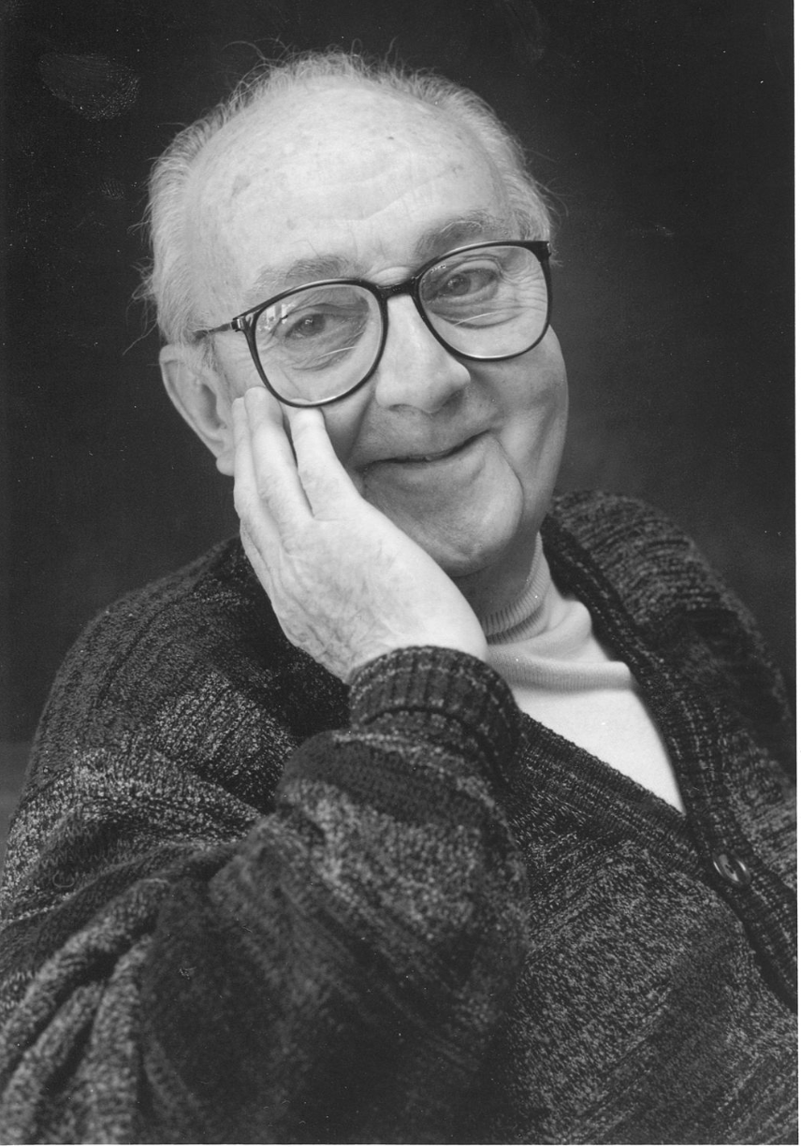
G.P.E. Box (Famous Statistician)
All models are wrong.
But some models are useful.

Slide 3
Agenda
Conceptual models
Variables and relationships
Dimensional analysis
Modeling Workflow
Example: Modeling the lac operon
Technical models with differential equations
Technical models with Markov Models
Review
Lecture Notes

Slide 4
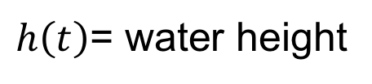
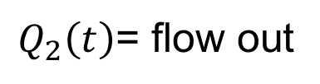
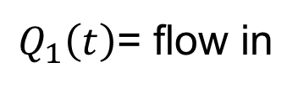
A Motivating Example: Modeling Water Flows and Levels for a Reservoir
$Q_{1}\left(t\right)$= flow in
(m³s⁻¹)
$h\left(t\right)$= water height
(m)
$Q_{2}\left(t\right)$= flow out
(m³s⁻¹)
m = meters
s = seconds
Notes:
What happens if height is too high? Limit of model?

Slide 5
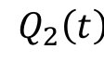
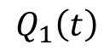
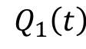
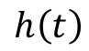
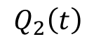
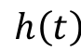
A conceptual model specifies variables and their roles.
$$Q_{1}\left(t\right)$$
$$h\left(t\right)$$
$$Q_{2}\left(t\right)$$
$$Q_{1}\left(t\right)$$
Variable Roles
Input. Exogenous variable that does not depend on the model.
Output. Computed variable of interest to the modeler.
State: Computed variable used to calculate output variables and/or other state variables.
Calculations
$$h\left(t\right)$$
$$Q_{2}\left(t\right)$$

Slide 6
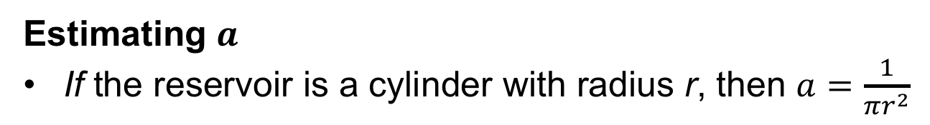

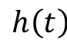
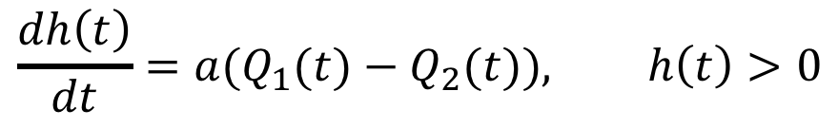
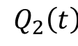
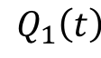
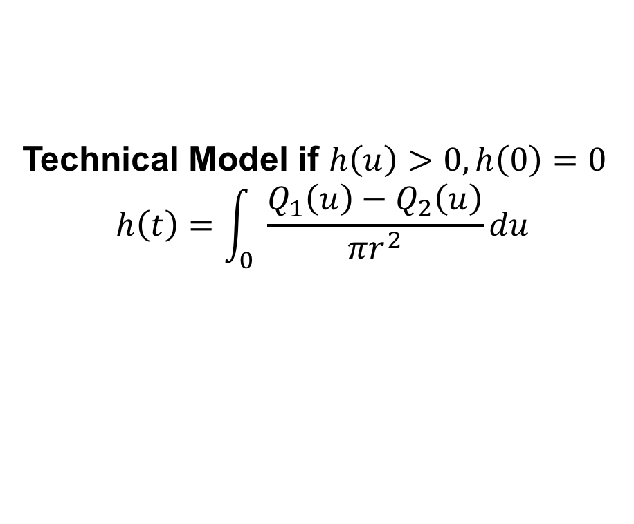
Technical models detail calculations.
$$Q_{1}\left(t\right)$$
Initial Technical Model
$$h\left(t\right)$$
$$\frac{dh\left(t\right)}{dt}={a(Q}_{1}(t)−Q_{2}(t)), h\left(t\right)>0$$
$$Q_{2}\left(t\right)$$
Issues
What if h(t) exceeds the height of the dam?
How is $a$ obtained?
Estimating $a$
If the reservoir is a cylinder with radius r, then $a=\frac{1}{πr^{2}}$
Technical Model if $h\left(u\right)>0, h\left(0\right)=0$
$$h\left(t\right)=\int_{0}{ \frac{{Q_{1}\left(u\right)−Q}_{2}\left(u\right)}{πr^{2}}du}$$
t

Slide 7
The reservoir is a cylinder?
The model is wrong.
But the model may be useful.

Slide 8
Steps In Modeling
Define the system boundaries, components, and available data.
Identify variables, dimensions, units.
Specify assumptions.
Ex: continuous approximations
Use ”mechanics” of system to construct mathematical relationships between variables.
Evaluate model quality and parameter certainties.
Ex: Differences between predicted and observed values.
Repeat.

Slide 9
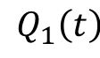
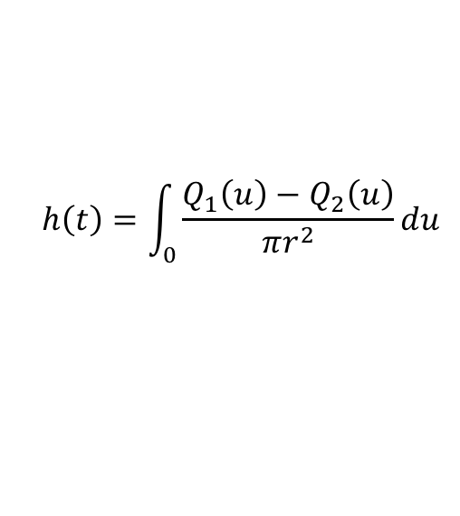
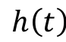
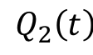
Modeling Workflow
System Diagram
Conceptual
Model
$$Q_{1}\left(t\right)$$
$$h\left(t\right)$$
$$Q_{2}\left(t\right)$$
V2.out
Technical
Model
t
$$h\left(t\right)=\int_{0}{\frac{{Q_{1}\left(u\right)−Q}_{2}\left(u\right)}{πr^{2}}du}$$

Slide 10
Model Characteristics
Linear vs. nonlinear
Static vs. dynamic
For dynamic: Time varying vs. time invariant
Lumped or distributed parameters
Deterministic vs. stochastic

Slide 11
Assumptions (Approximations)
Neglecting small effects (e.g., noise)
Environment does not change
Replace a complex system with a lumped system
Linear relationship

Slide 12
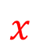
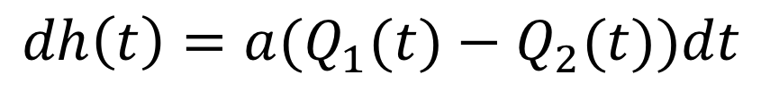
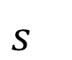
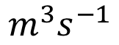
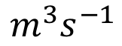
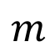
Dimensional Analysis
Why dimensional analysis?
Ensure consistent units.
Validate mathematical models.
Derive mathematical models.
$$dh\left(t\right)={a(Q}_{1}(t)−Q_{2}(t))dt$$
Height model
}
}
}
}
}
$$m$$
$$x$$
$$m^{3}s^{−1}$$
$$m^{3}s^{−1}$$
$$s^{}$$
Units

Slide 13
Rules for Dimensional Analysis
The units for a variable expression are that expression applied to the units of the variables.
Multiplying (dividing) units creates a compound unit.
Adding (subtracting) the same units gives the same units. Adding different units is undefined.
The units must be the same on both sides of an equals sign.
The arguments of transcendental functions (e.g., natural log) must be unitless.

Slide 14
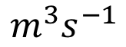
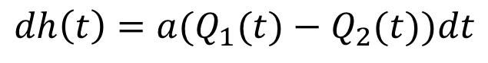
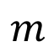
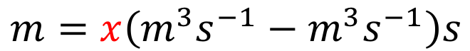

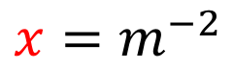
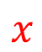
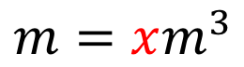
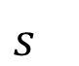
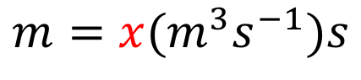
Solving for the units of $a$
$$dh\left(t\right)={a(Q}_{1}(t)−Q_{2}(t))dt$$
Rules
The units for a variable expression are that expression applied to the units of the variables.
Multiplying (dividing) units creates a compound unit.
Adding (subtracting) the same units gives the same units. Adding different units is undefined.
The units must be the same on both sides of an equals sign.
The arguments of transcendental functions (e.g., natural log) must be unitless.
}
}
}
}
}
$$m$$
$$x$$
$$m^{3}s^{−1}$$
$$m^{3}s^{−1}$$
$$s^{}$$
By Rules 1 & 4:
$$m=x\left(m^{3}s^{−1}−m^{3}s^{−1}\right)s$$
By Rule 3:
$$m=x(m^{3}s^{−1})s$$
By multiplication:
$$m=xm^{3}$$
By division:
$$x=m^{−2}$$

Slide 15
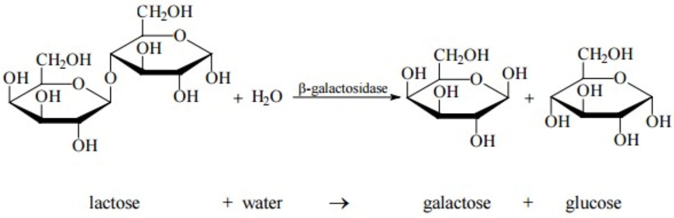
Modeling Example: lac Operon
Problem: yeast prefer glucose but sometimes only have access to lactose.

Slide 16
When Should Yeast Adapt?
Glucose | Lactose | lac Operon Transcription
+ | - | No adaptation
+ | + | Low adaptation
- | - | No adaptation
- | + | Strong adaptation

Slide 17
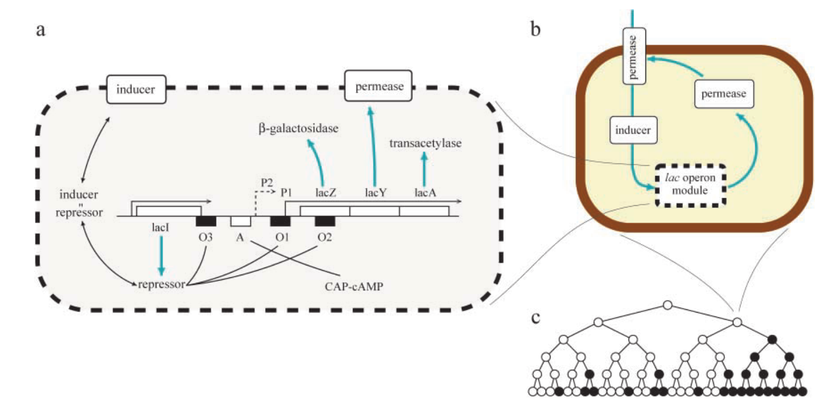
How Yeast Adapts: lac operon
Adaptations
Allow lactose into the cell
Convert lactose to galactose and glucose
*Vilar et al., 2003. Journal of Cell Biology.

Slide 18
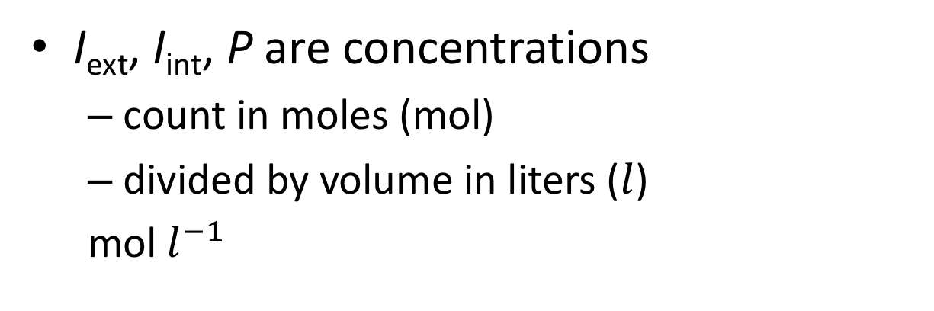
Modeling the lac Operon
I_{ext}
System Diagram
P
I_{int}
I_{ext} = external inducer (lactose)
I_{int} = internal inducer
P = permease
*Vilar et al., 2003. Journal of Cell Biology.
I_{ext}, I_{int}, P are concentrations
count in moles (mol)
divided by volume in liters ($l$)
mol $l^{−1}$

Slide 19
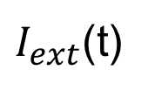
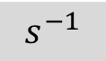
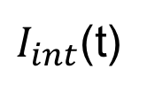
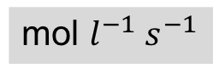
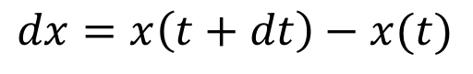
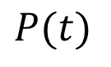
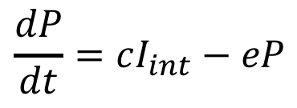
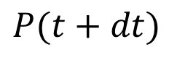
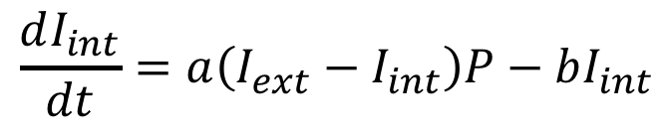
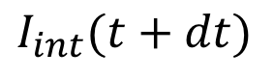
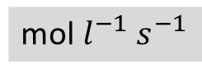
Modeling the lac Operon
I_{ext}
System Diagram
P
Simplified System Diagram
I_{int}
Conceptual Model
Technical Model
$I_{ext}$(t)
$I_{int}$(t)
$$P(t)$$
$$dx=x\left(t+dt\right)−x(t)$$
*Vilar et al., 2003. Journal of Cell Biology.
1:
$$\frac{dI_{int}}{dt}=a\left(I_{ext}−I_{int}\right)P−bI_{int}$$
1
2
$$\frac{dP}{dt}=cI_{int}−eP$$
$$I_{int}(t+dt)$$
$$P(t+dt)$$
2:
Questions
What are the units of dP/dt?
What are the units of c?
What are the units of a?
mol $l^{−1} s^{−1}$
$$s^{−1}$$
mol $l^{−1} s^{−1}$
Notes:
State vs. input variables for time?

Slide 20
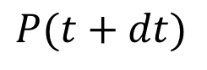







Technical Models With Differential Equations
Differential equations describe how variables change, typically with respect to time.
A differential is a small change
$dt$ is a small change in $t$
$dx(t)$ is the change from $x(t)$ to $x(t+dt)$
Lac operon: Concentration of inducer and permease
$I_{ext}$(t)
$I_{int}$(t)
$$P(t)$$
$$\frac{dI_{int}}{dt}=a\left(I_{ext}−I_{int}\right)P−bI_{int}$$
1
2
$$\frac{dP}{dt}=cI_{int}−eP$$
$$I_{int}(t+dt)$$
$$P(t+dt)$$

Slide 21
What We Assume Using a Model Based on Differential Equations
The system is deterministic
Repeated experiments produce essentially the same results
Counter example: Individual chemical reactions
Variables are continuous
Counter example: Small number of molecules

Slide 22


Solving Differential Equations Initial Value Problem (IVP)
Given derivative of variables and their initial values.
Find values of variables over time.
$$\frac{dx}{dt}=1, x\left(t_{0}\right)=0$$
Example:
Graphical solution
Place a point at initial value.
Draw a line with slope equal to the derivative.

Slide 23

A More Elaborate Initial Value Problem
Draw the curve
Initial value
Derivative

Slide 24


Euler Algorithm for IVP
Given: Differential equations and initial values for n variables
$\frac{dx_{n}(t)}{dt}=f_{n}\left(x_{1}\left(t\right),⋯,x_{N}\left(t\right)\right)$, ${ x}_{n}\left(0\right)$, h (dt estimate)
Find Values of variables at time 1,…,$T$
t = 0
For t <= T
For n = 1..N
delta = ${hf}_{n}\left(x_{1}\left(t\right),⋯,x_{n}\left(t\right)\right)$
$x_{n}\left(t+h\right)$ = $x_{n}\left(t\right)$+ delta
t = t + h

Slide 25

Phase Portrait
Geometric representation of how variables change.

Slide 26





Phase Portrait For lac Operon Model
$$\frac{dI_{int}}{dt}=a\left(I_{ext}−I_{int}\right)P−bI_{int}$$
$$\frac{dP}{dt}=cI_{int}−eP$$
Fixed point: All derivatives are 0.
Stable fixed point: Stays at fixed point.
$$a=1, b=0.1, c=1, e=0.5$$

Slide 27








Finding Fixed Points
Solve for variable values when derivatives are 0.
lac operon model
$$\frac{dI_{int}}{dt}=a\left(I_{ext}−I_{int}\right)P−bI_{int}$$
$$\frac{dP}{dt}=cI_{int}−eP$$
$$0=a\left(I_{ext}−I_{int}\right)P−bI_{int}$$
$$0=cI_{int}−eP$$
Solving:
$${I_{int}=I}_{ext}−\frac{be}{ac}$$
$$P=\frac{c}{e}I_{int}$$
For the values used:
$${I_{int}≈I}_{ext}$$
$$P≈2I_{ext}$$

Slide 28




Relating Steady Calculations to Phase Portrait
$${I_{int}≈I}_{ext}=3.0$$
$${I_{int}≈I}_{ext}=1.5$$
$$P≈2I_{ext}=6.0$$
$$P≈2I_{ext}=3.0$$

Slide 29


Types of Differential Equations
Ordinary differential equations
Only take derivative with respect to a single variable (e.g., time)
Partial differential equations have derivatives with respect to many variables
Linear differential equations
No products (or other functions) of variables being differentiated
We mostly have non-linear, ordinary differential equations
$$\frac{dI_{int}}{dt}=a\left(I_{ext}−I_{int}\right)P−bI_{int}$$
$$\frac{dP}{dt}=cI_{int}−eP$$

Slide 30











Differential Equations for Chemical Reactions
Differential
Equation
Reaction
Kinetics
$$A→B$$
$$kA$$
$$\frac{dA}{dt}=−kA$$
$$A+B→C$$
$$kAB$$
$$\frac{dA}{dt}=\frac{dB}{dt}=−kAB$$
$$A→B+C$$
$$kA$$
$$\frac{dA}{dt}=−kA$$
$$A+B→C+D$$
$$kAB$$
$$\frac{dA}{dt}=\frac{dB}{dt}=−kAB$$

Slide 31




How Concentrations Change
Reaction
Differential
Equation
Kinetics
$$A→B$$
$$kA$$
$$\frac{dA}{dt}=−kA$$

Slide 32

Technical Models With Markov Models
Motivation
Address situations where there are few molecules (e.g., low expression rates)

Slide 33




Markov Model Core Concepts
States: Specifies variable values that completely characterize how the system behaves
Transition rates: Probability per time unit of the system moving from state to state
State 1
$$r_{11}$$
State Diagram
$$r_{1N}$$
State N
$$r_{N,1}$$
$$r_{NN}$$

Slide 34



Markov Model Example:
$$A→B$$
State: Number of molecules of A (or B)
Transition: Change in the number of molecules of A as a result of a reaction
Each molecule of A reacts at a constant rate
$$λ$$
$$Nλ$$
$$λ$$
N
N-1
0
Notes:
Why are there only arrows between adjacent states? Why is the last array lambda?

Slide 35

Deterministic vs. Stochastic Model
Deterministic
(Differential Equation)
Stochastic

Slide 36


Effect of the Number of Molecules
100
10
1000

Slide 37






Markov Model Example:
$$A↔B$$
States?
Molecules of A
N is the sum of the molecules of A, B
State Diagram?
$$Nλ_{A}$$
$$2λ_{A}$$
$$Nλ_{B}$$
N
N-1
1
0
$$λ_{B}$$
$$λ_{A}$$
Notes:
Why are there only arrows between adjacent states? Why is the last array lambda?
B arrows go to the left; A arrows go to the right.

Slide 38
Data Sources
Who do I get…
Pathways, kinetics constants, gene networks, …
Metabolic pathways
Metabolic reconstruction (http://bigg.ucsd.edu/)
KEGG (https://www.genome.jp/kegg/)
MetaCyc (https://metacyc.org/)

Slide 39
Review
Conceptual model and variable roles
Input, output, state
Dimensional analysis
Rules
Modeling workflow
System diagram, conceptual model, technical model
Technical model: differential equations
Graphical solution
Technical model: Markov Model
State, transition, transition rates

Slide 40
BACKUP

Slide 41
Vocabulary for Modeling With Differential Equations
Increase
Decrease
With minimum
With maximum
Jointly increase with
Jointly decrease with
Activated by
Inhibited by

Slide 42
Notes
Modeling sequence
Population growth
Logistic regression for population min and max
Predatory prey
Consumption production
Activation/inhibition cascades
Types of stability. Linear vs. non-linear
Phase space
Key concepts
Falsifiable, accurate, predictive, parsimonious, selective (what is modelled), validation (establish relationship with experimental data)

